Slide 1
Global Software Development:
Issues, Solutions, Challenges
Parastoo Mohagheghi
Dept. Computer and Information Science (IDI)
University of Science and Technology (NTNU)
Trondheim, Norway
parastoo@idi.ntnu.no
Trial lecture, 21 September 2004

Slide 2
What is Global Software Development (GSD)?
Sahay (UiO) defines it as “software work undertaken at geographically separated locations across national boundaries in a coordinated fashion involving real time (synchronous) and asynchronous interaction” .
  Involves communication for information exchange.
  Involves coordination of groups, activities and artifacts so they contribute to the overall objective.
  Involves control of groups (adhering to goals and policies) and artifacts (quality, visibility & management).

Slide 3
Some figures on the extent of GSD
40% of the Fortune 500 companies use GSD, and 185 of these outsourced to India alone [Global Business Technology, NASSCOM, 2000].
Upwards to 50 nations are participating in GSD [Carmel, 2001].
IBM, British Airways, Alcatel, British Telecom and General Electric have moved parts of their software development to countries like Ireland and India [Khan, 2003].
80% of the Irish software industry’s output is exported [Cochran, 2001].
Gartner Dataquest has projected that IT outsourcing will reach $159 billion by 2005 [Laplante, 2004].
87 000 open source projects are hosted at SourceForge.net on Sept. 2004.

Slide 4
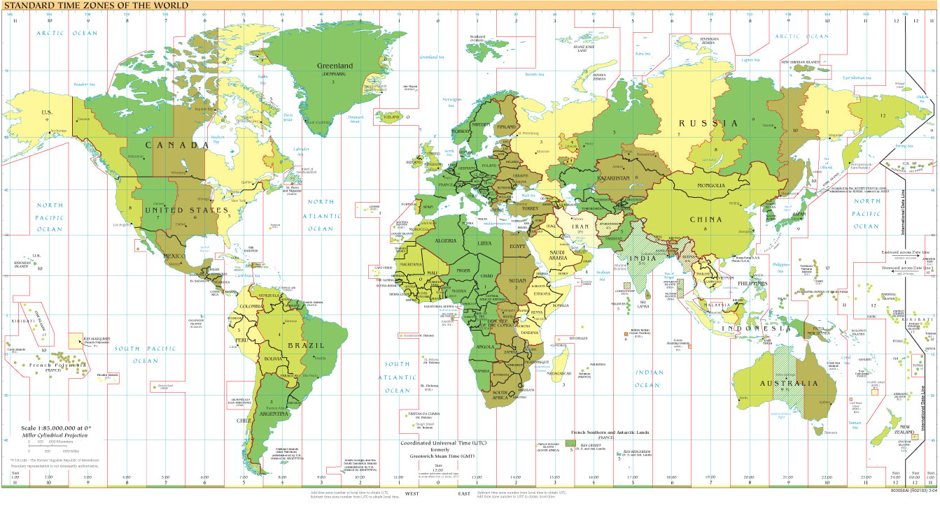
Worldwide development centers
IRELAND
FEW EUROPEAN
COUNTRIES
RUSSIA
US
CHINA
JAPAN
ISRAEL
INDIA
SINGAPORE
PHILIPPINNES
SOUTH AFRICA
AUSTRALIA
NEW ZEALAND

Slide 5




Why Global Software Development?
The “most given” answers
Cost saving,
overseas projects cost
about $25 per hour vs.
US $75 per hour
Solving local IT skills
shortage,
Motorala in 2000 had
only 20% of required
staff for 3G trial.
GSD
Remain focused on core competencies,
(outsourced functions are complex, important
or distasteful [Bruce Schneier, security expert]

Slide 6



Why Global Software Development?
A more complete picture
GSD
Competitive
advantage
New markets or
presence in the
local market
“Follow-the-sun”
development
Acquisitions &
mergers
Improved quality?
Impact on policies?

Slide 7
The four approaches to GSD
Intra-organizational or legally related companies;
  - E.g. Siemens, Lucent Technologies, IBM, Ericsson
Inter-organizational or outsourcing ;
  IT infrastructure, data centers, embedded software, maintenance or even software applications.
Open Source Software or non-organizational;
  OS like Linux, programs for programmers (editors, compiler).
Services or components over Web;
  Application Service Providers (ASP), pay-per-use services and recent component markets.

Slide 8
Benefits and risks of intra-organizational or inter-organizational global development
Benefits | Risks
Solution to IT skills shortage | Threat of opportunism, security and trust concerns, training, cultural issues
Cost efficiency | Hidden or unexpected costs, delay, the value and cost is intangible and long-term oriented, detailed spec.
Competitive advantage | Loss of control
Follow-the-sun development or Round-the-clock service | Geopolitical risks, coordination problems
New markets | Legal issues

Slide 9
Issues in GSD
Strategic issues: when, to whom and how, task allocation.
Communication issues: distance, time zone difference, infrastructure support, distinct backgrounds, lack of informal communication.
Coordination complexity
Cultural issues: power distance, individualism vs. collectivism, attitude to time etc.
Geographical dispersion: vendor support, access to experts, software practices that need face-to-face comm.
Technical issues: information and artifact sharing, software architecture.
Knowledge management: slow communication, poor documentation, tacit knowledge, repositories etc.

Slide 10
Overview of the remainder
Challenges in
Inter/intra org. GSD
Literature
overview
Communication
Open Source
answers
Culture
Summary
Organizational
models
Ericsson
example
Work
allocation

Slide 11
Communication
Communication type:
  Formal: for routine coordination, formal specifications or inspections or meetings.
  Informal: in the face of changes, informally captured requirements or out-of-date documents.
Tom Allen, 1977: The frequency of communication among engineers decreased with distance. Even 30 meters distance (same building or floor) is like miles away.
Some activities (e.g. requirement eng.) depend more on communication than others (e.g. testing).
Communication patterns: more with local and less with remote people.

Slide 12

Communication means
Synchronous Phone, video conference, Net meeting, E-chat, Instant Messaging | Asynchronous E-mail, voice-mail, discussion list, on-line calendar
Synchronous & Asynchronous Document sharing, Distributed Configuration Management (CM) systems, file transfer, remote access Special tools such as distributed blackboards, intelligent CM systems, experience browser
Awareness is knowing what is going on. Awareness
Systems filter information.

Slide 13
Cultural differences
Edward T. Hall (1976) identifies two dimensions:
  High context vs. low context cultures,
  Poly-chronic vs. mono-chronic cultures.
Geert Hofstede (2002) identified five views:
  Power distance, collectivism vs. individualism, feminity vs. masculinity, uncertainty avoidance, long-term vs. short term orientation
Other factors added by others:
  Emotional vs. neutral, attitude to time, race, class, religion, attitude to governments and specific vs. diffuse.
Cultures must be understood and respected. They could not be easily changed!

Slide 14
What is the impact of cultural differences on software development?
High power distance -> hierarchical forms of communication and slow decision making ( e.g. during requirement eng. in a study on Thai culture, 2000).
Uncertainty avoidance -> waterfall development models and restrictive change process (a study in 2003 comparing Japan, US and India).
Collectivism -> helping each other and correcting other people’s bugs (the same study, lowest for US).
US clients normally work with extensive written agreements and frequent e-mail contact, while Japanese prefer more verbal and continuous communication and less (but more formal) e-mail contact [Krishna from Indian companies, CACM, April 2004].

Slide 15

Managing cross-cultural relationships
Minimize cross-cultural issues or reduce intensive collaboration [Carmel 2001, Krishna 2004]:
  Project types: Embedded software, OS
  Contract types: contract programming, full ownership
Reduce cultural distance:
  Locals on-site (75/25 rule), staff who bridge cultures, common processes and work environment, personnel exchange, culture liaison etc.
Reduce temporal distance by communication means.
Recognize limits and learn from the other part.
  Reflect and share knowledge.

Slide 16

Relationships in IT outsourcing- FORT or Four Outsourcing Relation Types
Reliance: cost reduction,
outcome-based, formal
procedures to monitor vendor.
High
Reliance
Alliance
Extent of substitution
Alliance: strategic partnership,
common objectives and informal
comm. channels of importance.
Low
Support
Alignment
Low
High
Strategic impact of outsourced portfolio
Support: lowest set-up cost, out-come based, multiple bidding process.
Alignment: high-impact IS services, gain expertise, should
integrate the new system with existing ones and provide in-house personnel
for this, mostly dynamic and high-risk projects.

Slide 17
Work allocation
In-house
Outsourced
Alt.1: Transfer by development stage
Classic contract model, formal requirements, non-critical parts
Product
Mngt.
RE
Design
Code
Unit
test
System
test
Maint
enance
Implementation model, critical parts
Product
Mngt.
RE
Design
Code
Unit
test
System
test
Maint
enance
Product mngt. model, non-critical parts with further development
Product
Mngt.
RE
Design
Code
Unit
test
System
test
Maint
enance
Maintenance model
Product
Mngt.
RE
Design
Code
Unit
test
System
test
Maint
enance
Mockus, IEEE Software 2001,Nissan, ICSE workshop 2004

Slide 18
Work allocation- cont.
Alt.2: Transfer by functionality
Melvin Conway: a (software) product’s structure reflects the organizational
structure of the company that produced it.
David Parnas: software modularity should reflect the division of labor.
Solutions: systems or subsystems, horizontal layers or chunks of related
functionality (Mockus). Requires independent units of development.
Alt.3: Transfer by localization
Alt.4: Product line approach
Independent architectural units that do not need customization are
developed by collocated teams. Development of big chunks that need
customization is replicated in several locations. (Elbert 2001 on Alcatel,
Ericsson).
Common for all: Incremental approach
to facilitate communication and highlight ambiguities.

Slide 19

Other challenges in intra-org. and inter-org. global development
Organizational models: local managers at each site (with common visions).
Risk management, both at organizational level and project level.
New roles (e.g. management) and changed roles (interfacing vendor).
Pricing:
  Fixed or dynamic tied to effectiveness measures for low-risk projects,
  Time and material for high-risk projects,
  Maintenance in-house or external.
Adapting software processes.
Tools.

Slide 20
Open Source Software
Systems that give users free access to and the right to modify their source code.
Usually solve all the problems of distributed development using only very simple communication tools such as email and newsgroups, and change management systems such as CVS or Bugzilla.
Global access to developers. For example, the Apache project concerned with developing a HTTP (web) server included volunteers located in the US, Britain, Canada, Germany and Italy [Østerlie].
Some characteristics:
  There is no explicit system- level design or even detailed design.
  There is no project plan, schedule or list of deliverables.
  OSS projects have more frequent releases and rapid cycle time.

Slide 21
Open Source Software- cont.
No training,
Ad hoc alliances,
Free participation,
Work is not assigned,
Main motivation is learning
and creation,
Status by the practice of using.
Project leader
Core members (<15)
Active developers
Peripheral developers
Bug fixers
Bug reporters
Readers
Passive users (99% in Apache)
General structure of an OSS community
The developers must be users; there is generally no requirements gathering.
Bug finding and fixing is done by users -> low post-release defect density and
high productivity due to independence of tasks.
High modularized software, a highly capable (small ) core team and informal
coordination style -> speed
Other processes and practices: voting, wedging and forking.
Products: OS, compilers, system programs (Glass on Cathedral or Bazaar).

Slide 22
Quality impacts
Only a few case studies report concrete impacts of GSD on product or project attributes:
  Delay is the additional time it takes to resolve an issue when more than one site is involved. A study of modification requests (MRs) by at Lucent Technologies showed that single-site MRS took in average 5 days to complete, in contrast to 12,7 days for multi-site MRs (not related to size or number of changed modules, but to number of peoples involved) [Herbsleb et al. 2001].
  Boland et al. report reduced productivity due to asynchronous communication (how much?) [ICSE workshop, 2004].
  Others mention reduced defect-density and high productivity in OSS projects.
  Collocated teams achieved an efficiency improvement during initial validation activities of over 50 percent [Ebert, 2001]
Lack of quantitative results in general. What about cost, time-to-market, productivity in LOC etc.?

Slide 23
Empirical work
Several descriptive case studies and results of interviews. Some formulative papers. A few papers on new tools, one quantitative study on MRs and one simulation of delay.
on the supplier side, several papers from Indian researchers, but not from other nations.
Research topics:
  What type of projects should be (or might be) developed globally?
  Who should work with whom? It should be answered together with management and social scientists.
  What type of activities should be done collocated or distributed? For example should we do requirement eng. distributed?
  Is the distribution cost justifiable?
  What GSD needs in terms of practices, processes and tools?
  Developing tools, methods and techniques.
  Estimation, assessment of cost and impact on quality

Slide 24
Ericsson experience (from my thesis)
Application B, Sweden, Org. B
Application A, Norway
Product management
Business specific layer, Norway
Software architecture team
Software process
External,
Norway
Middleware, Norway
Platform, Sweden, Org. A
Also extensive
use of consultants
Initially:
Each organization did necessary requirement eng., design, coding and testing.
Final integration testing for the product was done in Germany.
Since 2002: maintenance of earlier releases is outsourced.
Product
Mngt.
RE
Design
Code
Unit
test
System
test
Maint
enance

Slide 25

Summary
GSD takes several forms.
Distance (time and space) creates many challenges in communication, coordination, organization, project planning and follow up, and work allocation.
Advances in communication technology and tools have brought GSD in focus. Questions regarding benefits and risks need detailed analysis in each case. Research should also map approaches or methodologies to problem domains.

Slide 26
Sources
ICSE workshops on OSS and GSD in 2001, 2002 and 2003.
IEEE Software March/April 2001.
Almost every issue of CACM since 2002!
Annual Hawaii International Conference on System Sciences (HICSS) since 1997.
ICSE main conferences.
A few papers from other sources: METRICS’01, Organizational Science Journal etc.

